Slide 1
Python Programming Language Foundation
Session 8
Notes:
1

Slide 2
Session overview
Testing
Types of tests
Python libraries for testing (unitttest)
Coverage
Approaches for development
Python Programming Solutions ©
2
Notes:
2

Slide 3
Testing
Python Programming Solutions ©
3

Slide 4
Complex definition
Software testing is an investigation conducted to provide stakeholders with information about the quality of the software product or service under test.
https://en.wikipedia.org/wiki/Software_testing
Python Programming Solutions ©
4

Slide 5
Simple definition
Software testing is the process of evaluating and verifying that a software product or application does what it is supposed to do.
https://www.ibm.com/topics/software-testing
Python Programming Solutions ©
5

Slide 6
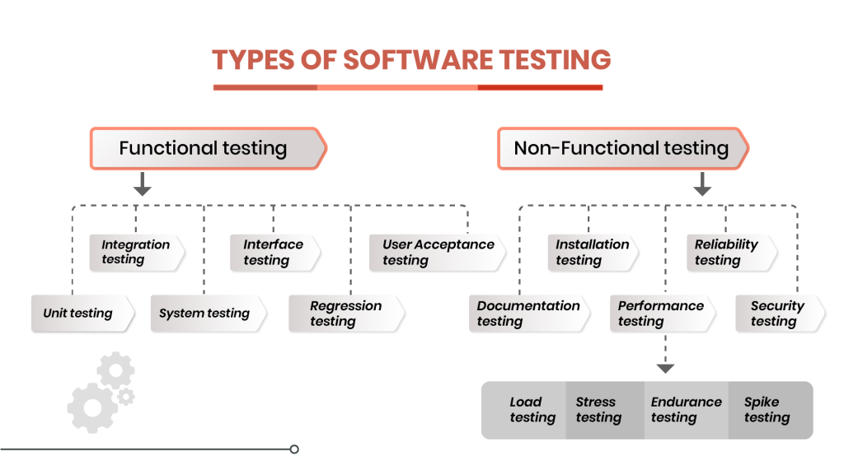
Types of tests
Python Programming Solutions ©
6

Slide 7
Testing benefits
Spot ambiguities early
Write better code in the first place
Measure Progress
Catch Regression Early
Release with confidence
Save time
Etc.
Python Programming Solutions ©
7

Slide 8
Cost of issue
Python Programming Solutions ©
8

Slide 9
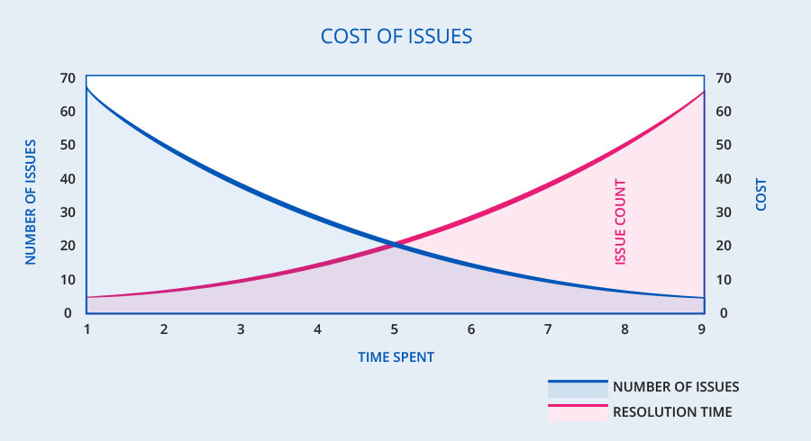
Cost of issue
Python Programming Solutions ©
9
Notes:
8

Slide 10
Unit testing
Run tests when a change occurs!
Python Programming Solutions ©
10

Slide 11
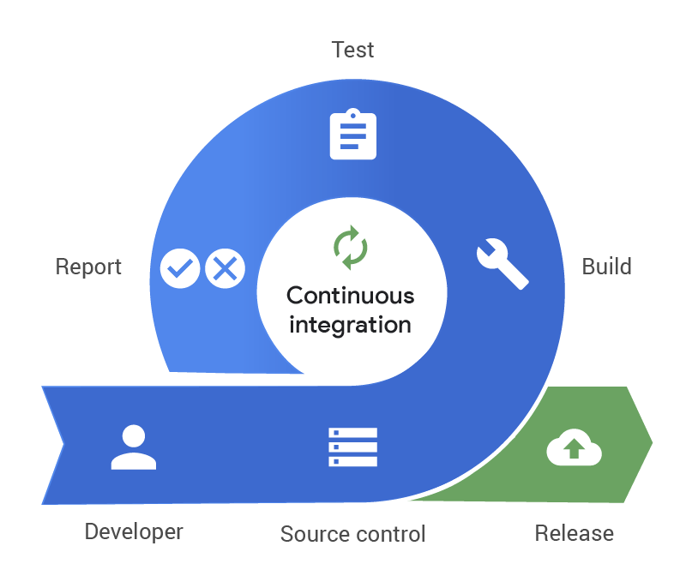
Continuous Integration
https://www.pagerduty.com/resources/learn/what-is-continuous-integration/​
Python Programming Solutions ©
11

Slide 12
Types of tests
Python Programming Solutions ©
12

Slide 13
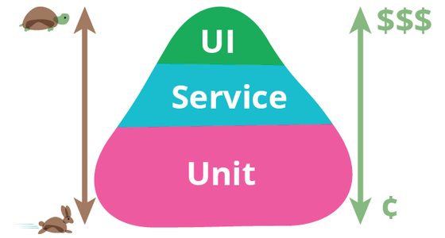
Testing pyramid
Python Programming Solutions ©
13
Notes:
12

Slide 14
Unit testing
Unit testing focuses on the smallest unit of a software design. It is often done by the programmer by using sample input and observing it’s corresponding output.
Python Programming Solutions ©
14

Slide 15
Integration testing
Integration testing is defined as a type of testing where software units are integrated with each other logicaly and tested as a group.
Python Programming Solutions ©
15

Slide 16
End to end testing
End to end testing is defined as a type of testing where the whole system behavior are tested under product-like circumstances.
Python Programming Solutions ©
16

Slide 17
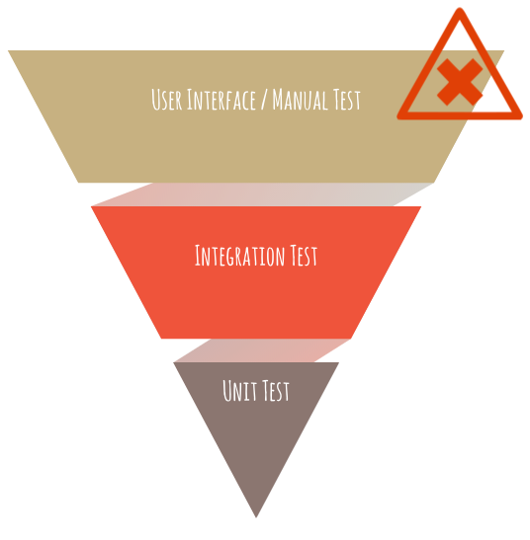
Inverted testing pyramid
Python Programming Solutions ©
17
Notes:
16

Slide 18
Python libraries
Python Programming Solutions ©
18

Slide 19
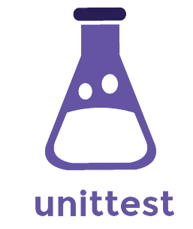
Python testing frameworks
Unittest is a unit testing framework for Python that was inspired by JUnit. It is the default Python testing framework that comes out of the box with the Python package.
Python Programming Solutions ©
19
Notes:
18

Slide 20
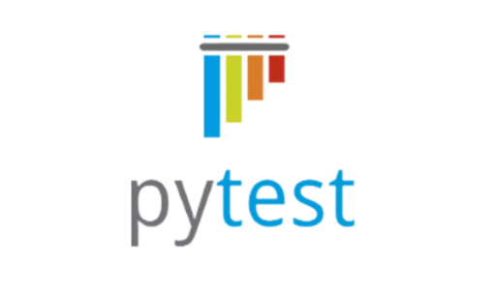
Python testing frameworks
Pytest is an open-source testing framework that is possibly on of the most widely used Python testing frameworks out there. Pytest is supports unit testing, functional testing and API testing as well.
Python Programming Solutions ©
20

Slide 21
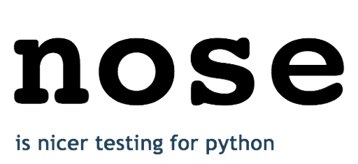
Python testing frameworks
Nose is basically Unittest, but with plugins. Nose extends Unittest beyond its functionality with various plugins that add support for test execution, test discovery, decorators, fixtures, parameterization, etc.
Python Programming Solutions ©
21

Slide 22

Python testing frameworks
Testify is designed to replace the common Unittest and Nose frameworks and has advanced features to the standard Unittest.
Python Programming Solutions ©
22

Slide 23
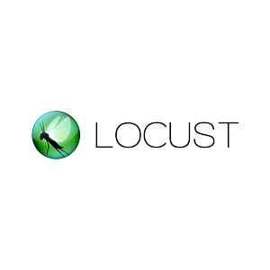
Python testing frameworks
Locust makes it easy to run load tests. You define the behaviour of your users in regular Python code, instead of being constrained by a UI or domain specific language that only pretends to be real code.
Python Programming Solutions ©
23

Slide 24
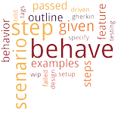
Python testing frameworks
Behave is the library for behaviour-driven development
Python Programming Solutions ©
24

Slide 25
Unittest
Python Programming Solutions ©
25

Slide 26
Test case
A test case is the individual unit of testing. It checks for a specific response to a particular set of inputs. unittest provides a base class, TestCase, which may be used to create new test cases.
https://docs.python.org/3/library/unittest.html
Python Programming Solutions ©
26

Slide 27
Test case
import unittest
class TestCaseExample(unittest.TestCase):
pass
Python Programming Solutions ©
27

Slide 28
Set up and tear down
The setUp() and tearDown() methods allow you to define instructions that will be executed before and after each test method.
https://docs.python.org/3/library/unittest.html
Python Programming Solutions ©
Python Programming Solutions ©
28
28

Slide 29
Set up and tear down
import unittest
class TestExample(unittest.TestCase):
def setUp(self):
db_connection = db.connect()
def tearDown(self):
db_connection.disconnect()
Python Programming Solutions ©
29

Slide 30
Asserts
Assert is a special method that return true if a specified condition is true and will stop the program with an optional message if condition is false. The TestCase class of the unittest framework provides several assert methods to check for and report failures.
https://docs.python.org/3/library/unittest.html
Python Programming Solutions ©
30

Slide 31
Asserts
import unittest
class TestExample(unittest.TestCase):
def test_example_equal(self):
self.assertEqual("ABC", "ABC")
self.assertNotEqual("ABC", "DEF")
def test_example_isdigit(self):
self.assertTrue('1337'.isdigit())
self.assertFalse('ABC'.isdigit())
Python Programming Solutions ©
31

Slide 32
Unittest structure
def split_string_by_comma(string): return string_to_split.strip().split(",")
class TestSplitString(unittest.TestCase):
def test_string_with_space(self):
# Arrange string_for_testing = " v,a,d"
# Act result = split_string_by_comma(string_for_testing)
# Assert self.assertEqual(result, ["v", "a", "d"])
Python Programming Solutions ©
32

Slide 33
Mocking
Mocking is a mechanism of testing that allows you to replace parts of your system under test with mock objects and make assertions about how they have been used.
https://docs.python.org/3/library/unittest.html
Python Programming Solutions ©
33

Slide 34

Mocking
Python Programming Solutions ©
34

Slide 35
Patching
Unittest.mock provides a powerful mechanism for mocking objects, called patch(), which looks up an object in a given module and replaces that object with a Mock. Patch() acts as a function decorator, class decorator or a context manager.
https://realpython.com/python-mock-library/
Python Programming Solutions ©
35

Slide 36
Coverage
Python Programming Solutions ©
36

Slide 37
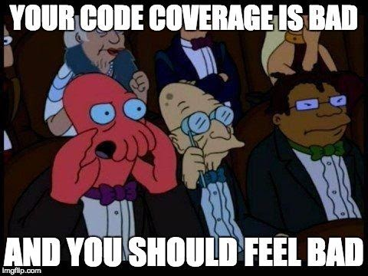
Coverage
Simply coverage is the answer for the question “What we are testing and how much we are testing ?”
Python Programming Solutions ©
37

Slide 38
Benefits of coverage monitoring
Identifying and eliminating test cases that don’t make much sense in the current project.
Identifying areas of a program that have not been covered by a set of test cases.
You save time by eliminating defects earlier and faster.
Test coverage also helps in Regression testing and test suite minimization.
Python Programming Solutions ©
38

Slide 39
Statement Coverage
def is_positive(number): if number > 0: return True else: return False
Name Stmts Miss Cover Missing
----------------------------------------------
script.py 4 1 75% 5
Python Programming Solutions ©
39

Slide 40
Statement Coverage
def is_positive(number): return number > 0
Name Stmts Miss Cover Missing
----------------------------------------------
script.py 2 0 100%
Python Programming Solutions ©
40

Slide 41
Branch Coverage
def is_positive(number): if number > 0: return True
Name Stmts Miss Branch BrPart Cover Missing
------------------------------------------------------------
script.py 3 0 2 1 80% 2->exit
Python Programming Solutions ©
41

Slide 42
Approaches for development
Python Programming Solutions ©
42

Slide 43
Test Driven Development (TDD)
Test Driven Development can be defined as a development practice in which you write a test for some functionality first, then create this functionality to make the test pass. That way, developers can be confident that they’ve written code that does the job.
Python Programming Solutions ©
43

Slide 44
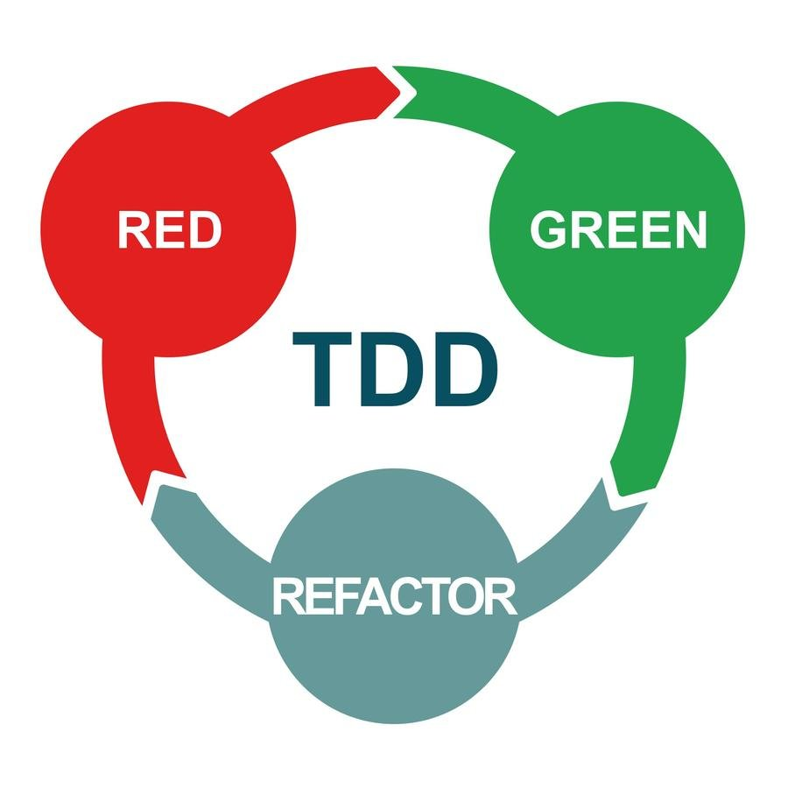
Test Driven Development (TDD)
Python Programming Solutions ©
44

Slide 45
Behavior Driven Development (BDD)
Simply Behavior Driven Development (BDD) is an agile software development technique that encourages collaboration between developers, QA and non-technical or business participants in a software project.
Python Programming Solutions ©
45

Slide 46
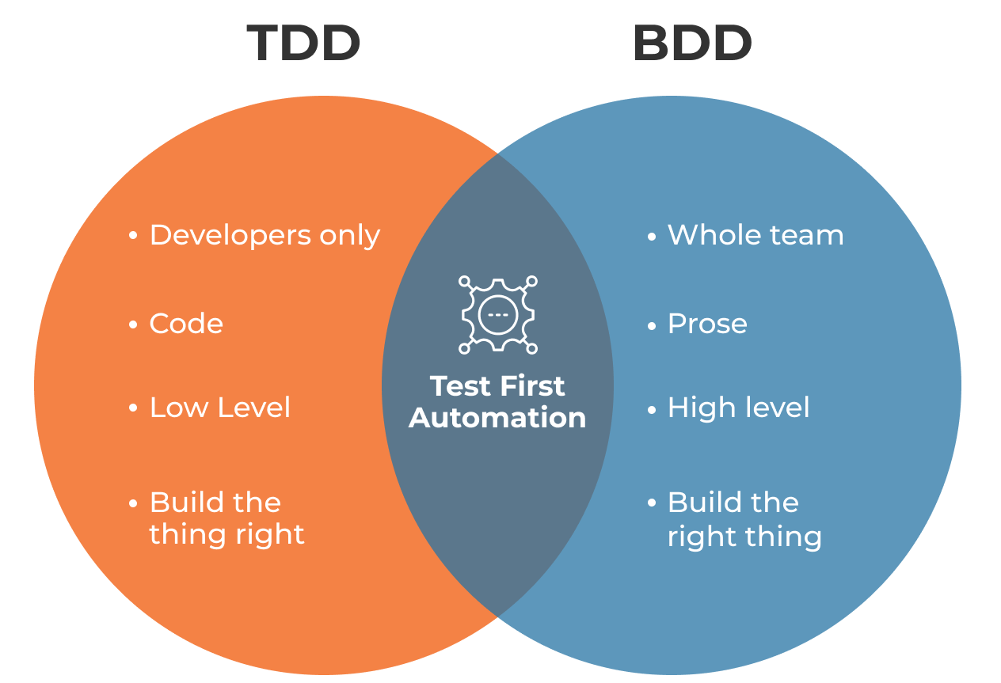
TDD VS BDD
Python Programming Solutions ©
46

Slide 47
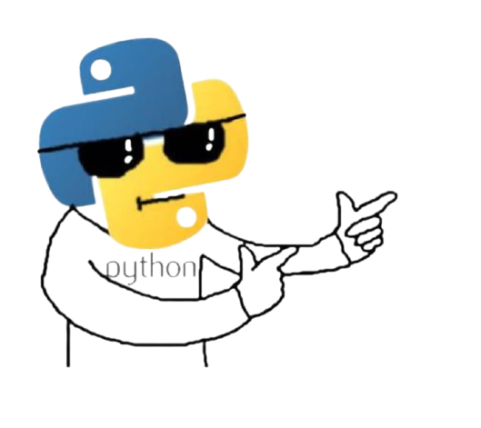
Thanks for attention
Questions?
Python Programming Solutions ©
47
Notes:
45

